Slide 1
Found candidates receptor ligand pairs in self-renewal satellite cell
Collaboration with Penney GILBERT
Analysis : Legrand’s team :
Dr. Penney M. Gilbert
PhD Erik JACQUES
RA Nitya GULATI
Trainee Saif RJAIBI
Dr. Fabien LE GRAND
IE Johanna GALVIS-LACROUX
IE William JARASSIER
IE Pauline MOULLÉ

Slide 2
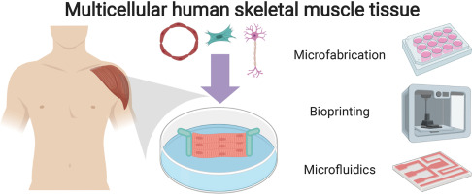
Penney GILBERT project
Construct miniaturized versions of human skeletal muscle tissue in a dish for:
Drug discovery effort
Fundamental studies
muscle stem cell mediated repair
Duchenne muscular dystrophy
exercise …
Objective collaboration:
Test the power of an in silico --> in vitro pipeline for discovery of satellite cell modulators
Louise A. Moyle, Erik Jacques, Penney M. Gilbert, Engineering the next generation of human skeletal muscle models: From cellular complexity to disease modeling, Current Opinion in Biomedical Engineering

Slide 3
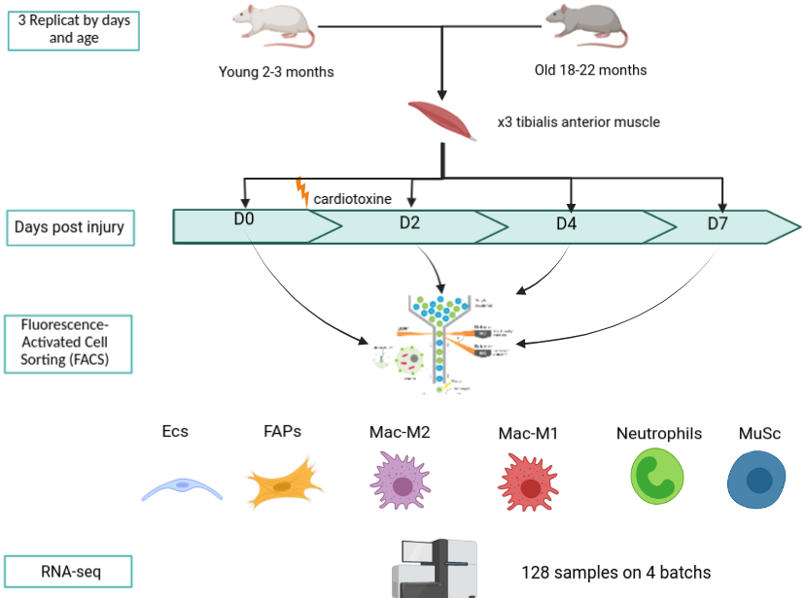
Le Grand data
With the collaboration of Dr. Bénédicte CHAZAUD and Dr. Jérôme FEIGE teams RNA-seq data following this design experiment are available:

Slide 4
Le Grand data
With the collaboration of Dr. Bénédicte CHAZAUD and Dr. Jérôme FEIGE teams RNA-seq data following this design experiment are available:
Cell sequenced | D0 | D2 | D4 | D7
ECs
FAPs
Mac-M1
Mac-M2
Neutrophils
MuSc

Slide 5
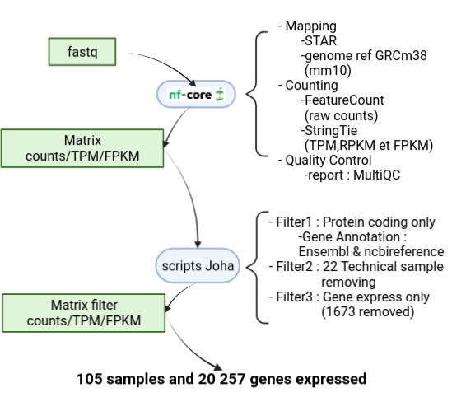
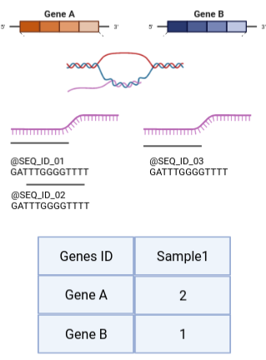
Pretreatment RNA-seq data

Slide 6
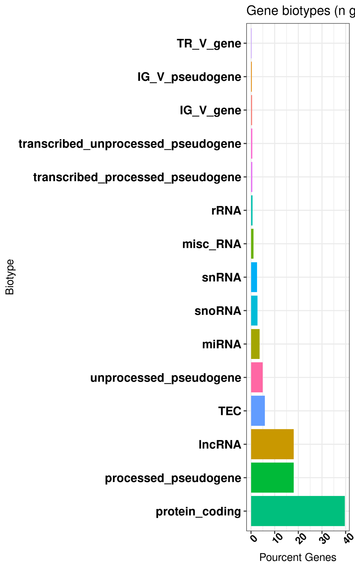
Pretreatment RNA-seq data

Slide 7
Natmi zoom
Network Analysis Toolkit for Multicellular Interaction (NATMI) Hou, R., Denisenko, E., Ong, H.T. et al. Predicting cell-to-cell communication networks using NATMI. Nat Commun 11, 5011 (2020).
Develop for single cell sequencing
Adaptation for bulk RNA sequencing :
Considerate one replicate like one cell
Software base on:
Expression table with TPM value
Database Ligand Receptor ConnectomeDB2020
→ Interaction relevate if the receptor and the ligand expressed >= 0.6 ration cell expression
Notes:
Publicly available resource of 2293 human ligand-receptor pairs manually curated with literature. ConnectomeDB2020 is hosted at the University of Western Australia (Hou,Small et al., 2020). For vertebrate species other than human, inference is based on human ortholog mappings provided in the NCBI HomoloGene Database.

Slide 8
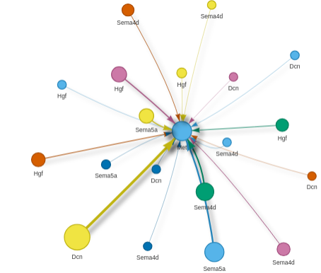
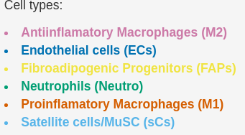
Natmi zoom
Results informations:
For receptor and ligand:
Type cell
Symbol gene
Detection rate or percent of replicate with expression
For receptor, ligand and edge (product ligand receptor value):
Average expression value - meanTPM
Derived specificity of average expression value
Exemple representation of results:
All interaction in D2 for young expression with
Met in satellite cell
Notes:
Publicly available resource of 2293 human ligand-receptor pairs manually curated with literature. ConnectomeDB2020 is hosted at the University of Western Australia (Hou,Small et al., 2020). For vertebrate species other than human, inference is based on human ortholog mappings provided in the NCBI HomoloGene Database.

Slide 9
Collaboration :
Penney Gilbert team
Objective:
Discovery satellite cells modulators
Focus on
Boosting in self-renewal states
Boosting in quiescence states
Factors that we could 'add into' the system easily (ECM, GFs, cytokines, etc)
Receptor doesn’t change much, and then suddenly a ligand becomes accessible

Slide 10
Collaboration :
Le Grand team - Bioinformatique point of view
Penney Gilbert team
Objective:
Discovery satellite cells modulators
Focus on
Boosting in self-renewal states
Boosting in quiescence states
Factors that we could 'add into' the system easily (ECM, GFs, cytokines, etc)
Receptor doesn’t change much, and then suddenly a ligand becomes accessible
Analyse Data
Focus on Young RNA-seq data
Explore Natmi result - Receptor-Ligand results
Focus on
Receptor expressed by satellite cells
Receptor expressed all days and replicats
Ligand expressed by all type cells
Split analysis on two:
‘n’ for “boosting in self-renewal states” :
Expression D0< D2
Expression D7< D4
‘U’ for “boosting in quiescence states”
Expression D0> D2
Expression D7> D4

Slide 11
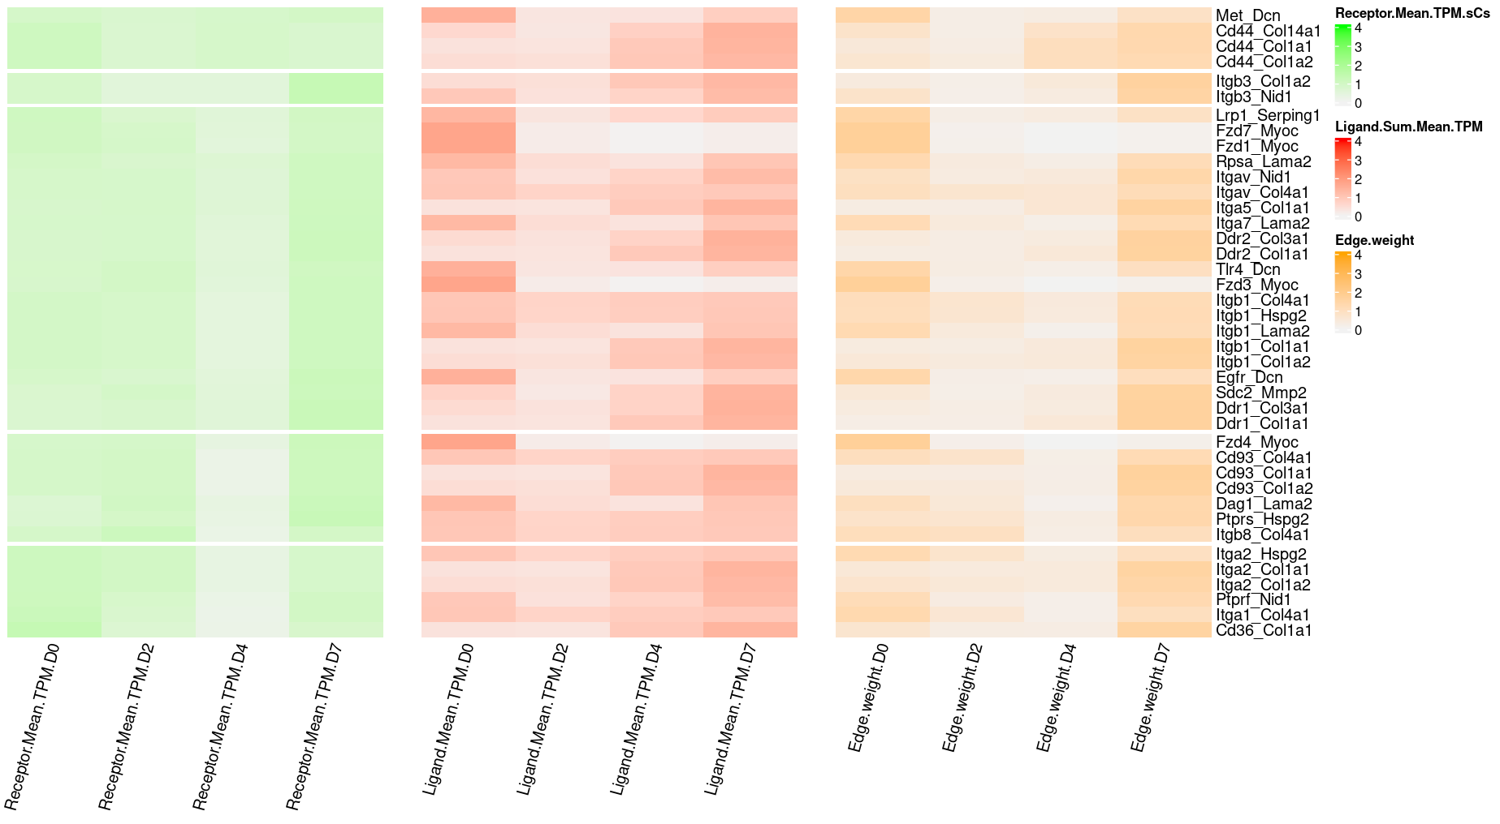
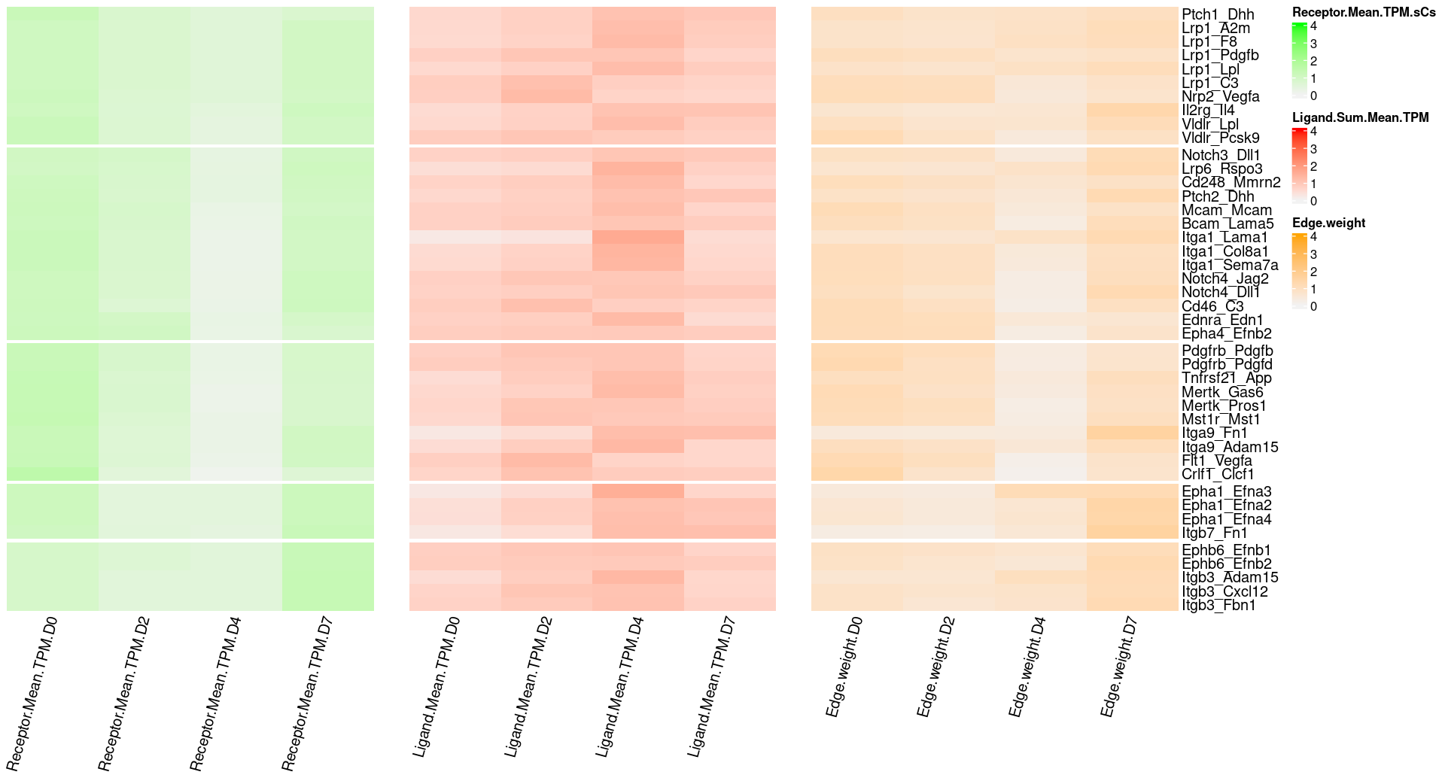
Top 40 candidates receptor-ligand
Boosting in quiescence states

Slide 12
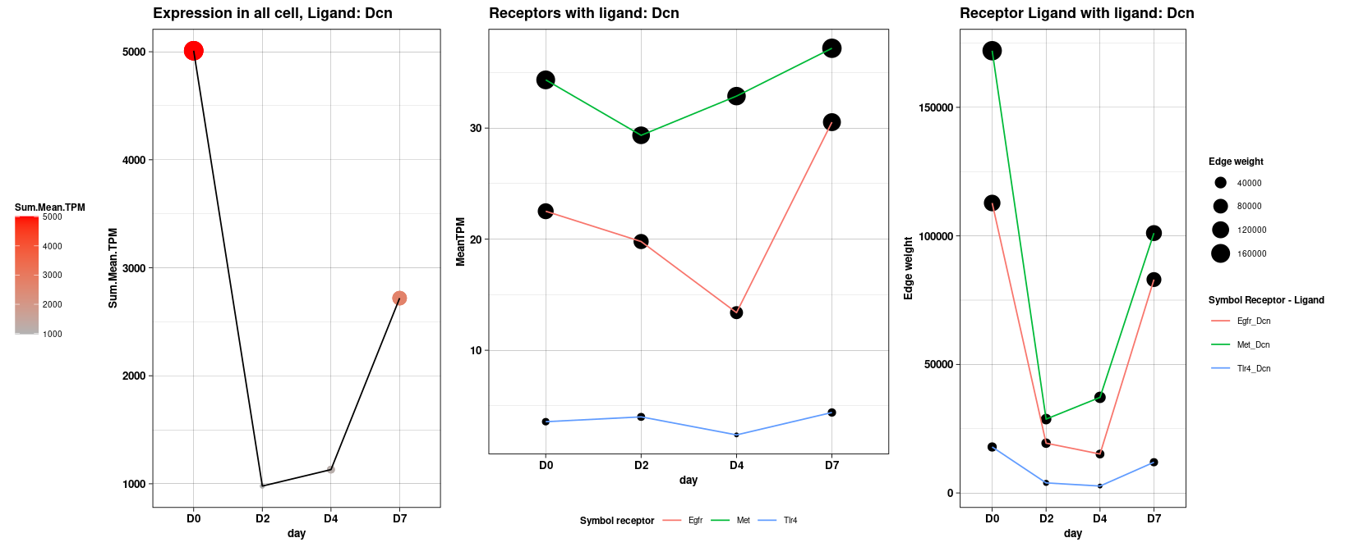
Candidates receptor-ligand
Boosting in quiescent state: zoom couple Met_Dcn
Explore all interaction with ligand Dcn
Notes:
Met, a receptor tyrosine kinase -> dysregulated expression in numberous malignancies and is involved in cancer growth, metastasis and invasion
Decorin extracellular matrix (ECM) protein -> DCN regulates the bioactivities of cell growth factors and participates in ECM assembly

Slide 13
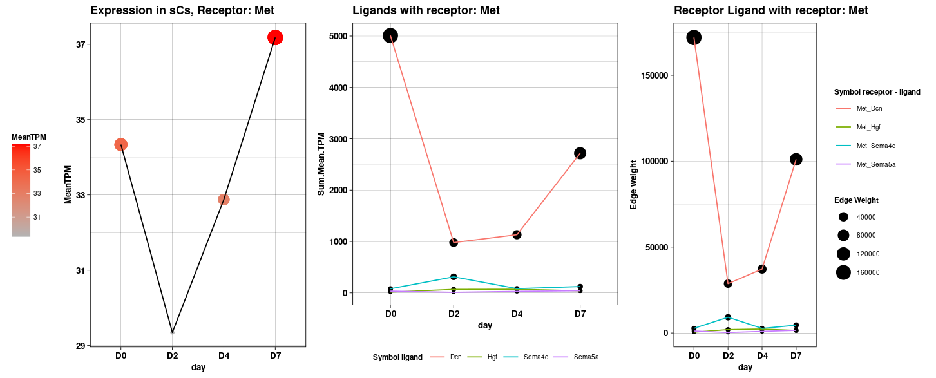
Candidates receptor-ligand
Boosting in quiescent state: zoom couple Met_Dcn
Explore all interaction with receptor Met
Notes:
Met, a receptor tyrosine kinase -> dysregulated expression in numberous malignancies and is involved in cancer growth, metastasis and invasion
Decorin extracellular matrix (ECM) protein -> DCN regulates the bioactivities of cell growth factors and participates in ECM assembly

Slide 14
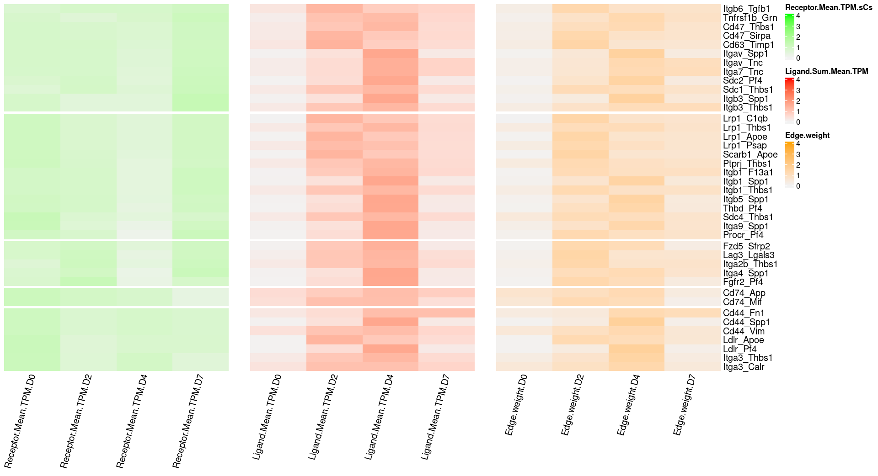
Top 40 candidates receptor-ligand
Boosting in self-renewal states
Notes:
CD44 family of surface receptors regulates adhesion, movement, and activation of cell.
Osteopontin Spp1 induces cellular chemotaxis but not homotypic aggregation
Effect on cell migration and growth

Slide 15
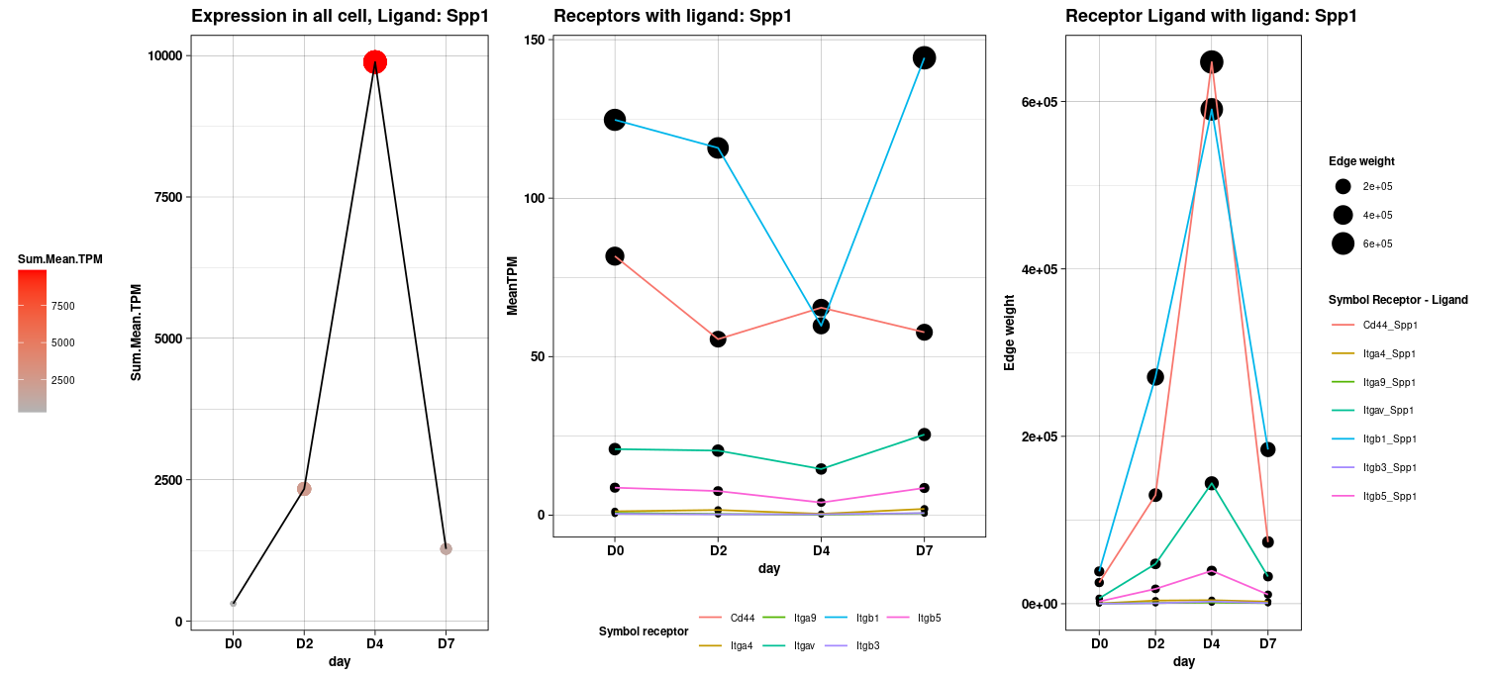
Candidates receptor-ligand
Boosting in self-renewal states : zoom couple Cd44_Spp1
Explore all interaction with migand Spp1
Notes:
CD44 family of surface receptors regulates adhesion, movement, and activation of cell.
Osteopontin Spp1 induces cellular chemotaxis but not homotypic aggregation
Effect on cell migration and growth

Slide 16
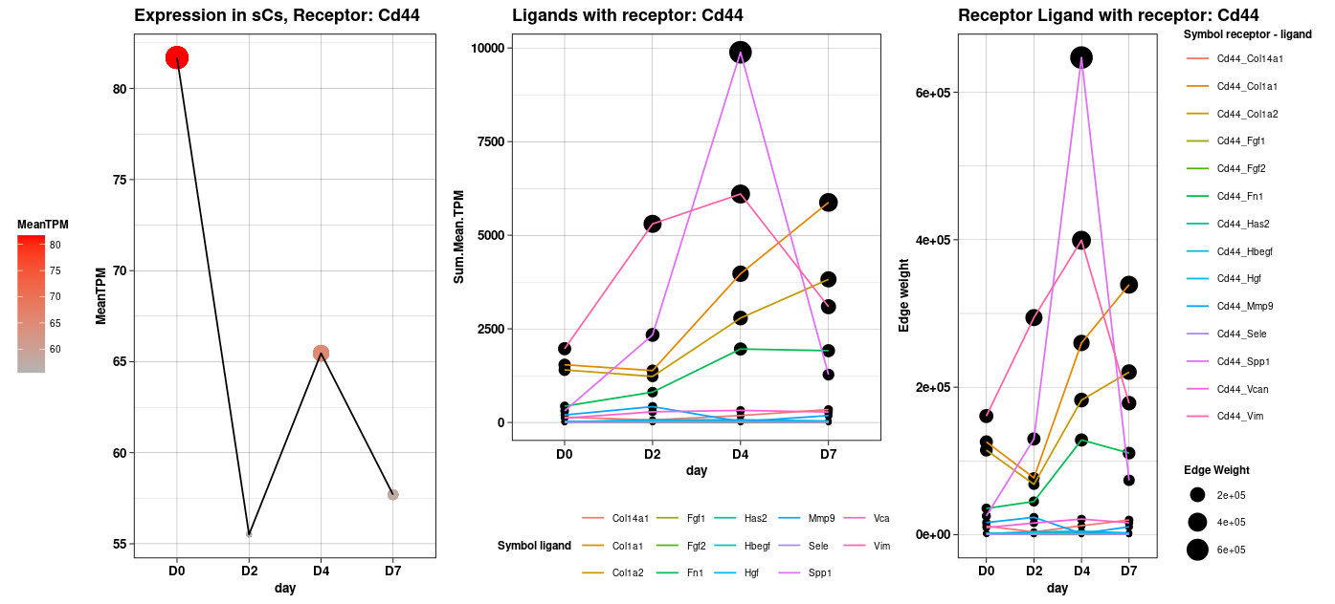
Candidates receptor-ligand
Boosting in self-renewal states : zoom couple Cd44_Spp1
Explore all interaction with receptor Cd44
Notes:
CD44 family of surface receptors regulates adhesion, movement, and activation of cell.
Osteopontin Spp1 induces cellular chemotaxis but not homotypic aggregation
Effect on cell migration and growth

Slide 17

RNA-seq analysis of 6 cell types in regeneration muscle tissue between young and old mice
Partenariat des équipes de:
Dr. Fabien LE GRAND
Dr. Bénédicte CHAZAUD
Dr. Jérôme FEIGE
Contributeurs Principaux:
PhD Hoang DIEU-HUONG
IE Johanna GALVIS-LACROUX
IE William JARASSIER
IE Pauline MOULLÉ

Slide 18
Objective analysis - experimental design
Found difference between expression Old and Young mice in regeneration muscle tissue.
Cell sequenced | D0 | D2 | D4 | D7
ECs
FAPs
Mac-M1
Mac-M2
Neutrophils
MuSc

Slide 19
Steps of analyse
Differential Expressed Genes
Gene Set Enrichment Analysis
Receptors Ligands Analysis

Slide 20
Steps of analyse
1
Differential Expressed Genes
On gene with on less 3 samples with raw count >= 5 (2 460 gene remove)
DEG Old-Young for each 18 conditions TypeCell.DayPostInjury
25% (5902) genes are padj<0.05 on less one condition

Slide 21
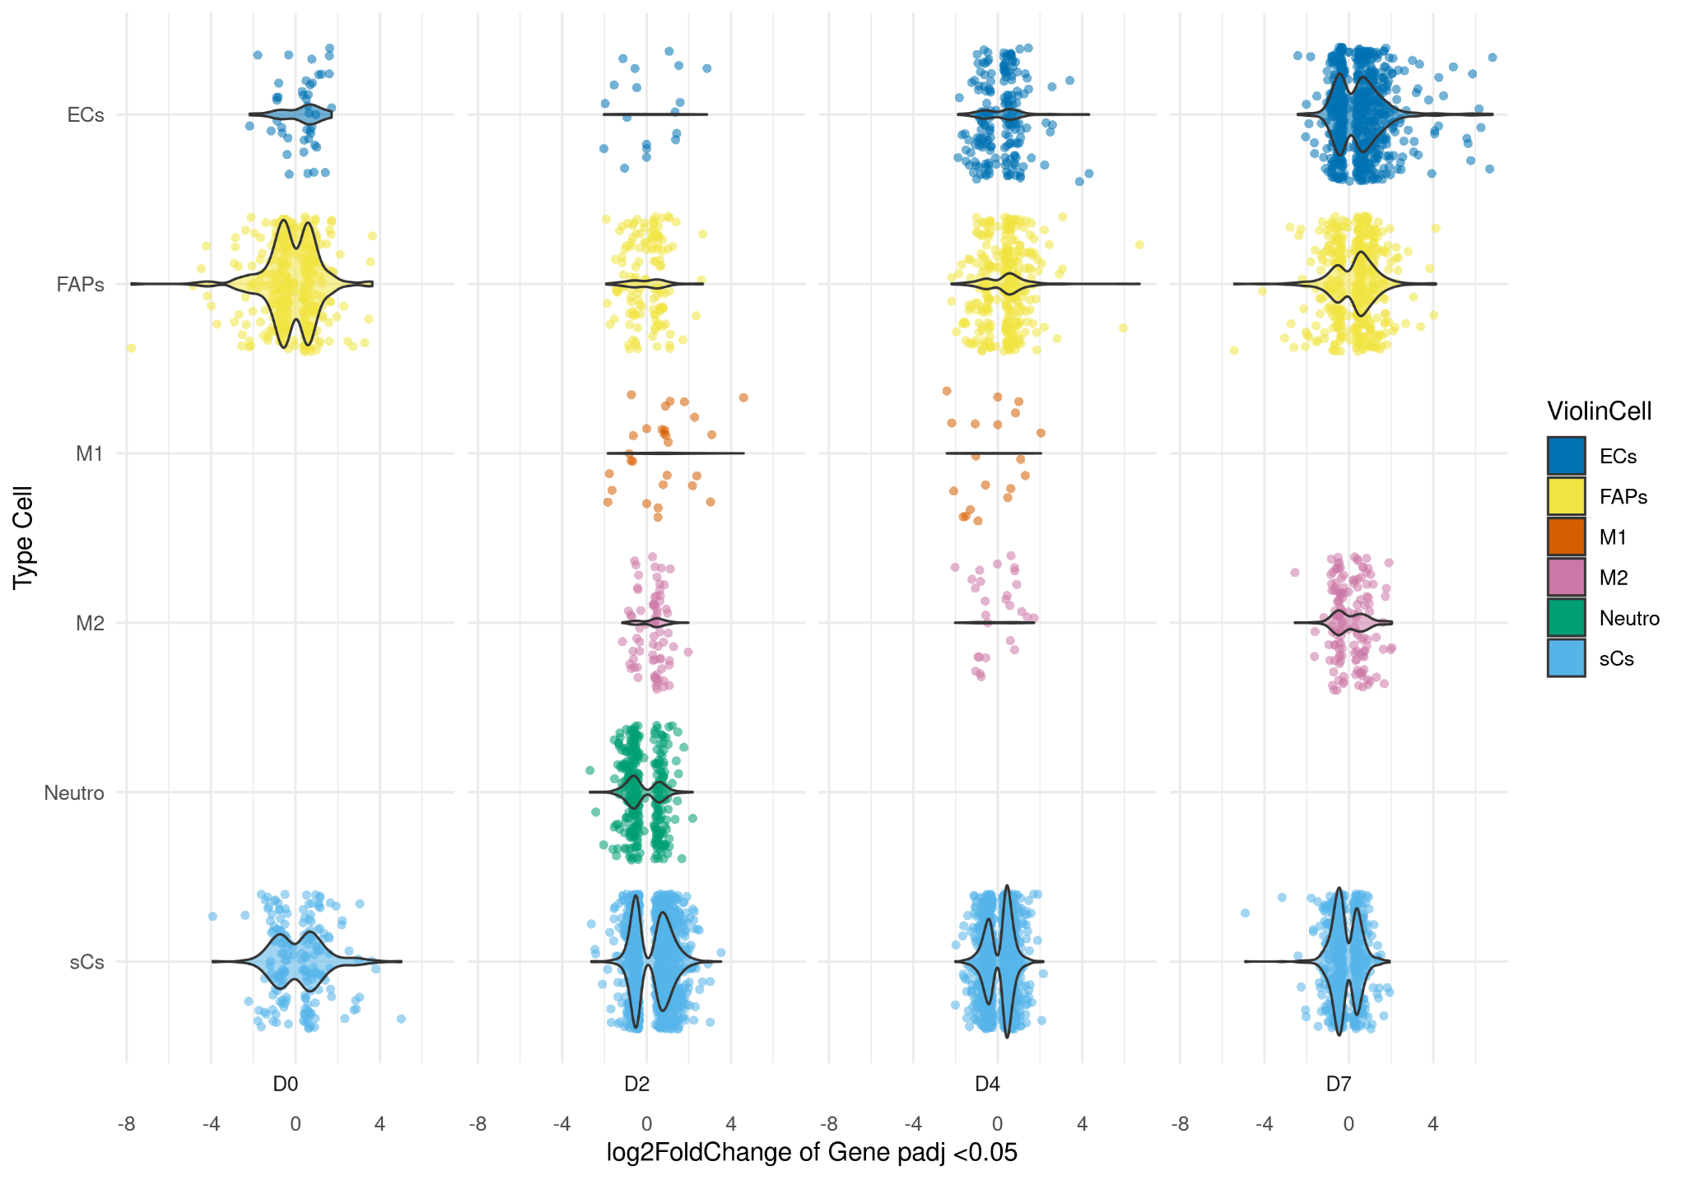
1 Differential Expressed Genes
Proportion of genes DEG signi
 | ECs | FAPs | sCs | M1 | M2 | Neutro
D0 | 1.6 | 8.7 | 8.1 | NA | NA | NA
D2 | 1.0 | 4.0 | 32.3 | 0.5 | 1.6 | 5.3
D4 | 4.7 | 6.6 | 23.4 | 0.3 | 0.6 | NA
D7 | 10.4 | 7.0 | 10.1 | NA | 2.4 | NA

Slide 22
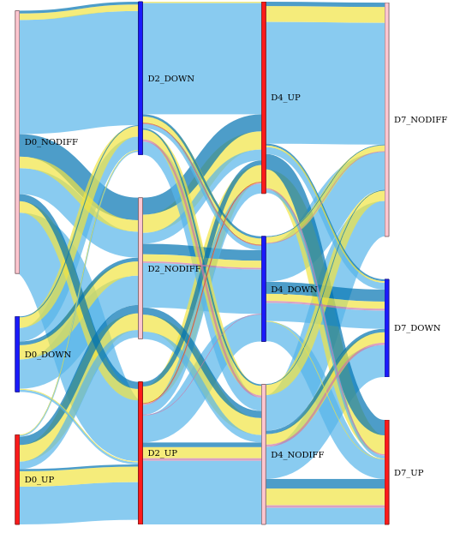
1 Differential Expressed Genes
symbol | nbDayDE | Dynamic | id | day | type | padj | log2FoldChange | meanCountNormalizedYoung | meanCountNormalizedOld
C4b | 3 | D2_UP.D4_UP.D7_UP | ENSMUSG00000073418 | D2 | M2 | 2.26814288079248e-10 | 1.9075 | 67.5574 | 267.4453
C4b | 3 | D2_UP.D4_UP.D7_UP | ENSMUSG00000073418 | D4 | M2 | 0.00032536183106648 | 0.963 | 317.4045 | 656.2569
C4b | 3 | D2_UP.D4_UP.D7_UP | ENSMUSG00000073418 | D7 | M2 | 1.12878271495032e-15 | 1.3087 | 594.9828 | 1508.9978
C4b | 2 | D2_UP.D4_UP | ENSMUSG00000073418 | D2 | M1 | 8.90563367792302e-8 | 1.9639 | 145.8828 | 604.7223
C4b | 2 | D2_UP.D4_UP | ENSMUSG00000073418 | D4 | M1 | 0.0112502470567319 | 0.8397 | 520.7154 | 1004.215
C4b | 1 | D2_UP | ENSMUSG00000073418 | D2 | Neutro | 0.00168117762706364 | 1.7635 | 42.3539 | 170.0887
C4b | 1 | D2_UP | ENSMUSG00000073418 | D2 | sCs | 0.0000276347552724158 | 1.5361 | 92.4862 | 293.1857
C4b | 1 | D4_UP | ENSMUSG00000073418 | D4 | FAPs | 1.35176274617256e-9 | 0.9665 | 1399.785 | 2811.6533
C4b | 1 | D7_UP | ENSMUSG00000073418 | D7 | ECs | 0.002927150522015 95 | 3.2702 | 1.9394 | 26.72

Slide 23
Steps of analyse
Algorithme : fGEA use in R
Database:
Genes Set from Molecular Signatures Database
(MSigDB) species Mus musculus
category C2 subcategory = Canonical pathways
Reactome database
Differential Expressed Genes
2
On each days and cellType
On “all” genes
Sort by signed of log2FoldChange * - log10(padj)
Approx 3 000 genes with padj = NA
Gene Set Enrichment Analysis

Slide 24
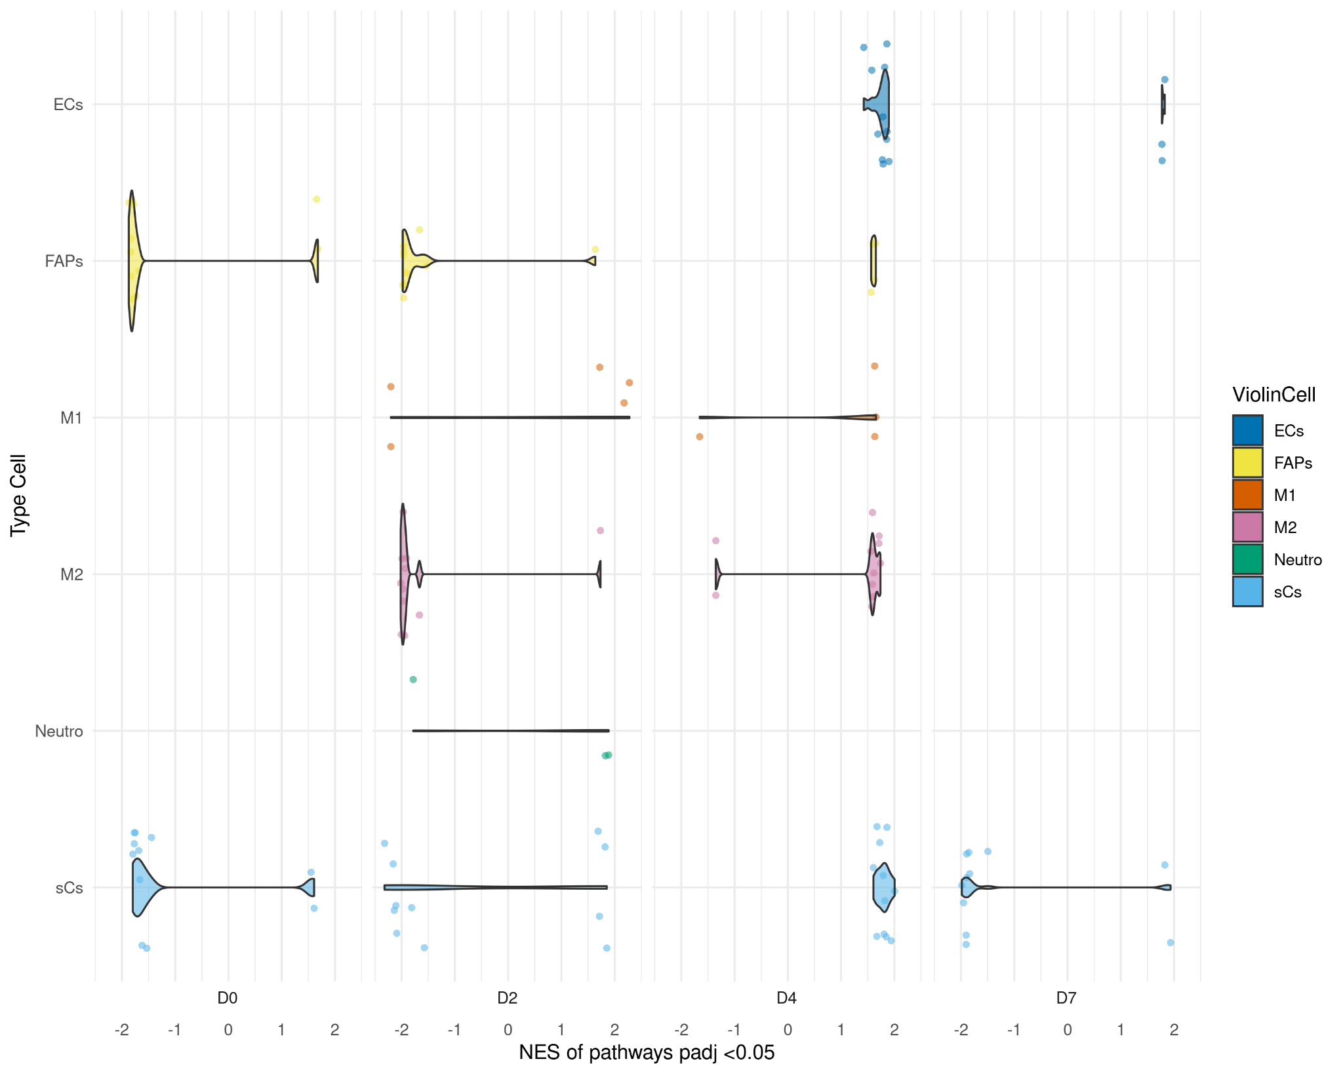
2 Gene Set Enrichment Analysis
Proportion of pathway DE signi
 | ECs | FAPs | sCs | M1 | M2 | Neutro
D0 | 0 | 71 | 72 | NA | NA | NA
D2 | 0 | 78 | 384 | 5 | 11 | 3
D4 | 115 | 4 | 325 | 4 | 18 | NA
D7 | 3 | 0 | 20 | NA | 0 | NA

Slide 25
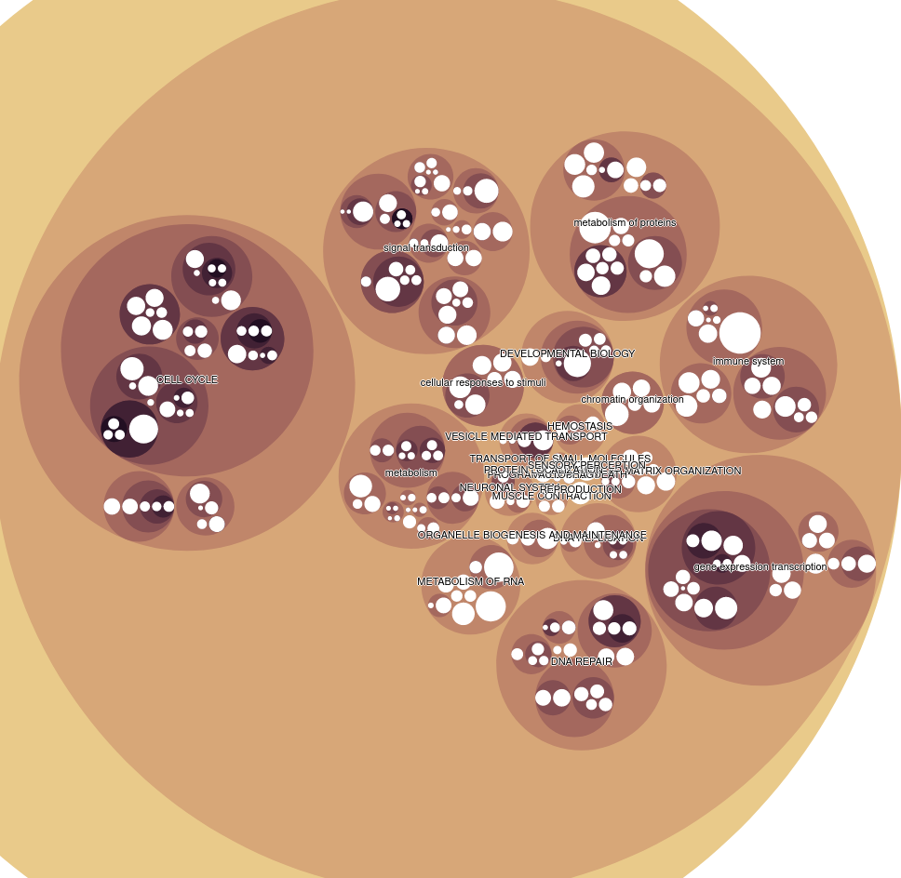
2 Gene Set Enrichment Analysis
AUTOPHAGY
IN REACTOME HIERARCHIE | AUTOPHAGY | MACROAUTOPHAGY | SELECTIVE AUTOPHAGY | AGGREPHAGY
CELL CYCLE
IN REACTOME HIERARCHIE | CELL CYCLE | CELL CYCLE CHECKPOINTS | G1 S DNA DAMAGE CHECKPOINTS | P53 DEPENDENT G1 S DNA DAMAGE CHECKPOINT | P53 DEPENDENT G1 DNA DAMAGE RESPONSE | STABILIZATION OF P53
IN REACTOME HIERARCHIE | CELL CYCLE | CELL CYCLE CHECKPOINTS | G2 M CHECKPOINTS | ACTIVATION OF ATR IN RESPONSE TO REPLICATION STRESS
IN REACTOME HIERARCHIE | CELL CYCLE | CELL CYCLE CHECKPOINTS | G2 M CHECKPOINTS | G2 M DNA DAMAGE CHECKPOINT

Slide 26
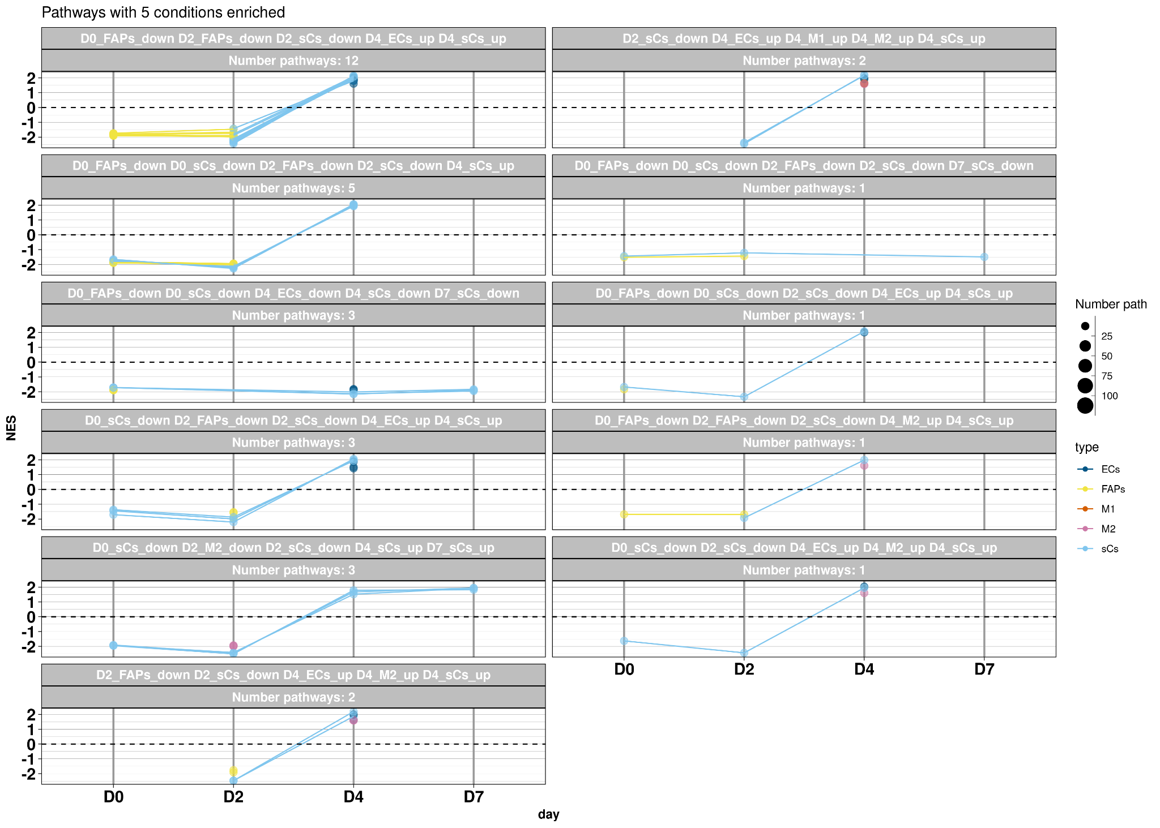
2 Gene Set Enrichment Analysis
Numbers conditions enrichis | 1 | 2 | 3 | 4
Numbers pathways | 254 | 139 | 46 | 28
Numbers conditions enrichis | 5 | 6 | 7 | 8
Numbers pathways | 34 | 22 | 3 | 1

Slide 27
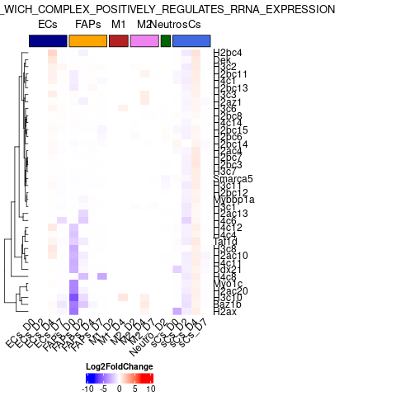
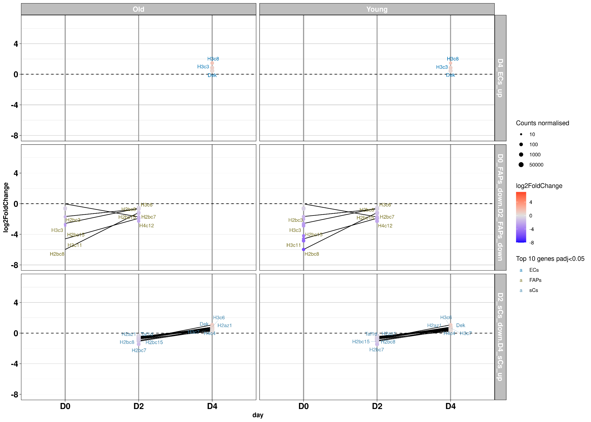
2 Gene Set Enrichment Analysis
CondSigni | NamePathway | link | DayTypeSens | padj | NES | NbPathWithDynamique
D0_FAPs_down D2_FAPs_down D2_sCs_down D4_ECs_up D4_sCs_up | B WICH COMPLEX POSITIVELY REGULATES RRNA EXPRESSION | FigureSupp | D0_FAPs_down | 0.00534289344241228 | -1.83663650472637 | 12

Slide 28
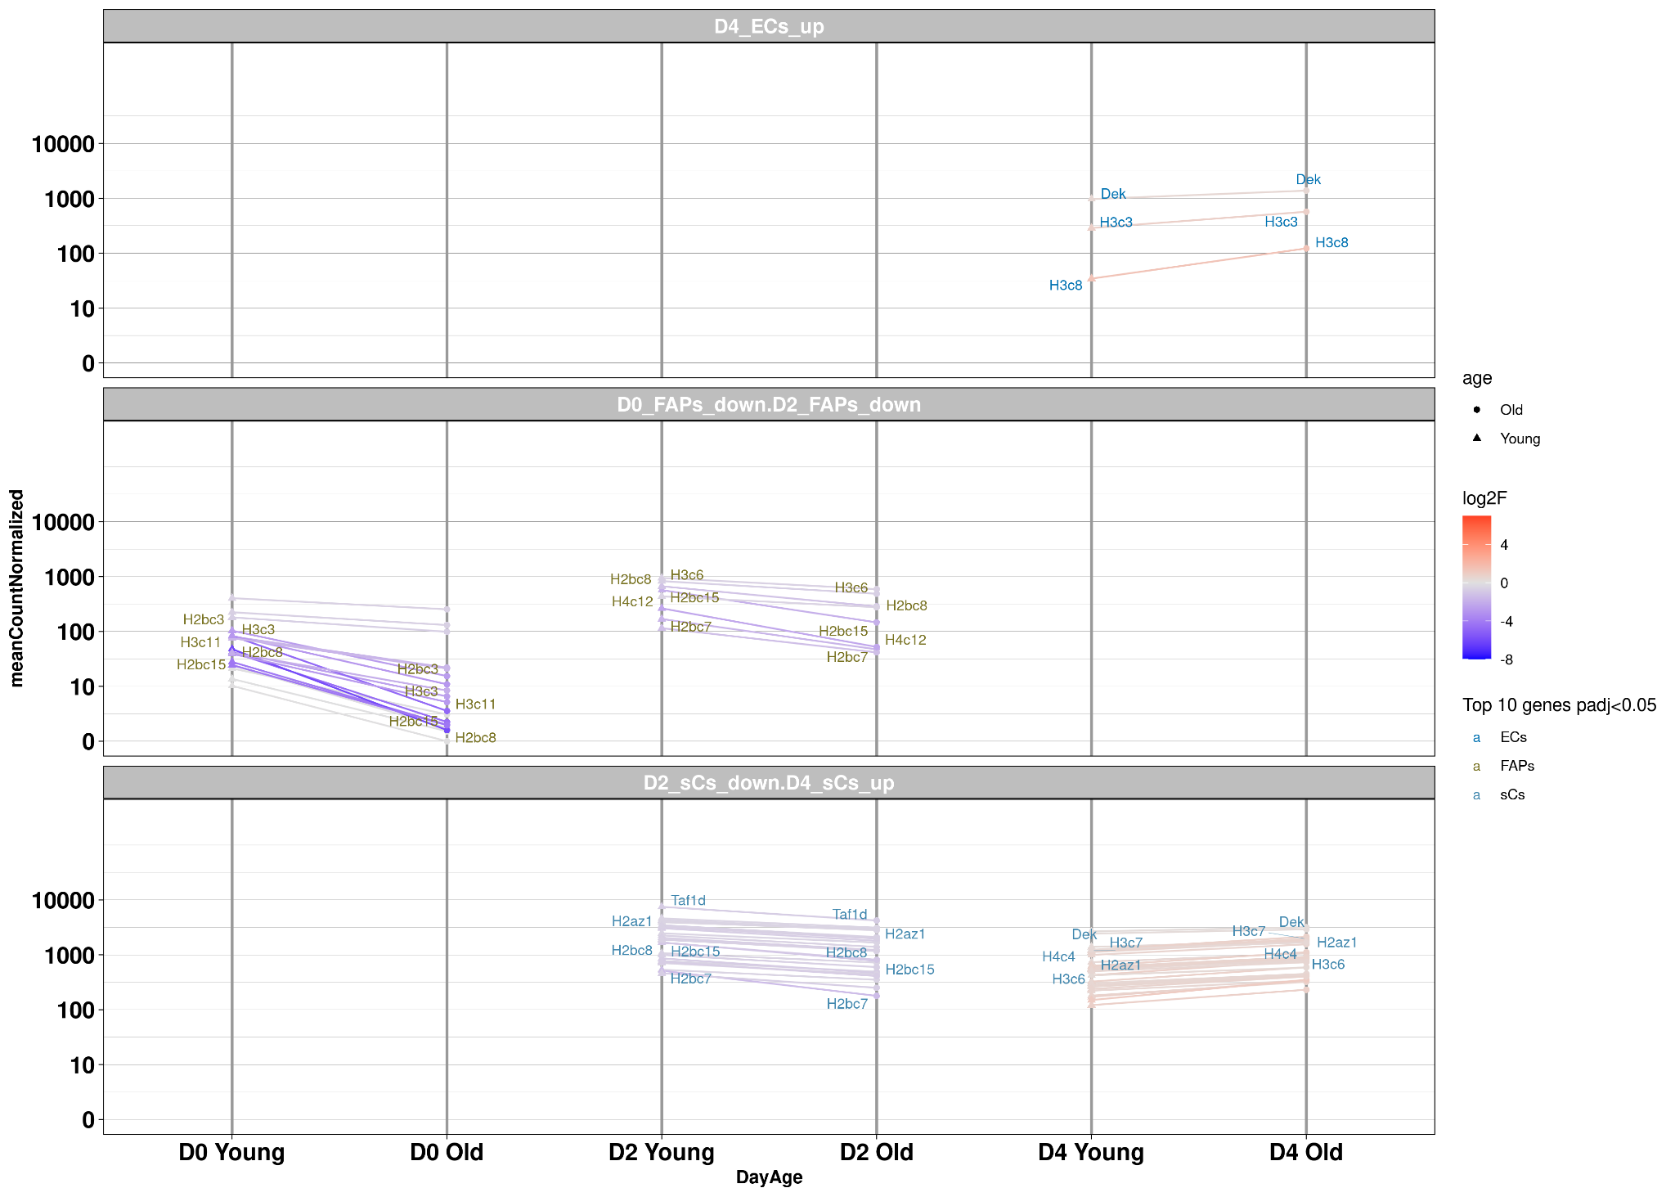
2 Gene Set Enrichment Analysis
CondSigni | NamePathway | link | DayTypeSens | padj | NES | NbPathWithDynamique
D0_FAPs_down D2_FAPs_down D2_sCs_down D4_ECs_up D4_sCs_up | B WICH COMPLEX POSITIVELY REGULATES RRNA EXPRESSION | FigureSupp | D0_FAPs_down | 0.00534289344241228 | -1.83663650472637 | 12

Slide 29
Steps of analyse
Network Analysis Toolkit for Multicellular Interaction (NATMI) Hou, R., Denisenko, E., Ong, H.T. et al. Predicting cell-to-cell communication networks using NATMI. Nat Commun 11, 5011 (2020).
Develop for single cell sequencing
Adaptation for bulk RNA sequencing :
Considerate one replicate like one cell
Software base on:
Expression table with raw Count Normalised value
Database Ligand Receptor Connectome DB2020
Differential Expressed Genes
3
Gene Set Enrichment Analysis
Receptors Ligands Analysis

Slide 30
3 Receptors ligands analysis
Available information by couple receptor ligand:
- Day
Type Receptor
DEG info: padj,log2fodchange
Expression Young Old
Detection rate
- Edge Infos
- Expression weight
-Delta edge young old
-Log2foldchange
Type Ligand
DEG info: padj,log2fodchange
Expression Young Old
Detection rate
→ Simplification : groupe type cell → Receptor or Ligand DEG at less in one condition
→ Try to curate receptor ligand with comparaison expression Ligand associated to a receptor

